Slide 1
Database
Velocity training institute
Shantanu Mahajan (sr engg devops)

Slide 2
What is a database?
A database is an organized collection of structured information, or data, typically stored electronically in a computer system.
A database is usually controlled by a database management system (DBMS).
Together, the data and the DBMS, along with the applications that are associated with them, are referred to as a database system, often shortened to just database.
Data within the most common types of databases in operation today is typically modeled in rows and columns in a series of tables to make processing and data querying efficient.
The data can then be easily accessed, managed, modified, updated, controlled, and organized. Most databases use structured query language (SQL) for writing and querying data.

Slide 3
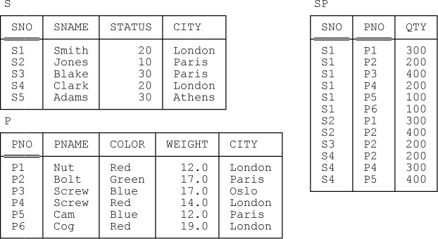
Example of Database

Slide 4
Advantages of using a Database
Database minimizes data redundancy to a great extent:- No repetitive Data
The database can control the inconsistency of data to a large extent. – Same data but may receive from different inputs
Sharing of data is also possible using the database.
Database enforce standards:- Standards are common practices that ensure the consistency and effectiveness of the database environment,
The use of Databases can ensure data security.
Integrity can be managed using the database:- Data integrity is the overall accuracy, completeness, and consistency of data

Slide 5
Types of Database
Hierarchical database systems.
Network database systems.
Relational Database System
Non Relational DB systems

Slide 6
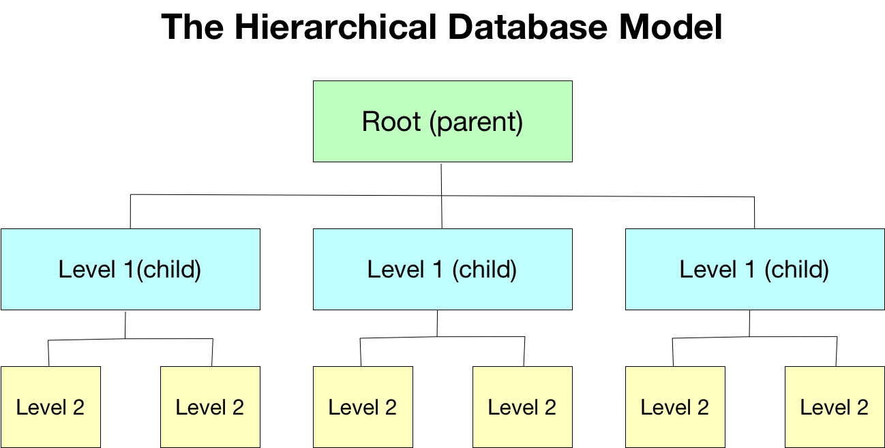
Hierarchical database systems.
A hierarchical database is a data model in which data is stored in the form of records and organized into a tree-like structure, or parent-child structure, in which one parent node can have many child nodes connected through links.

Slide 7
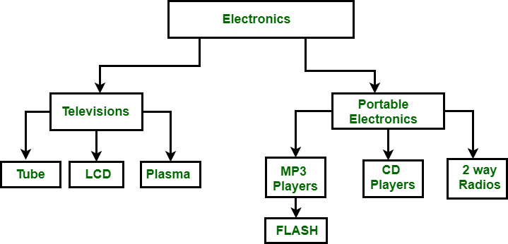

Slide 8
Network Database systems
A network database is a type of database model wherein multiple member records or files can be linked to multiple owner files and vice versa.
Eg Integrated Data Store (IDS) Raima Database Manager. Univac DMS-1100. IDMS (Integrated Database Management System)

Slide 9
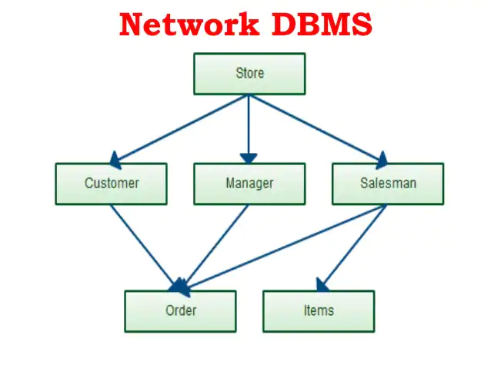

Slide 10
Relational Database
A relational database is a type of database that focuses on the relation between stored data elements.
It allows users to establish links between different sets of data within the database and use these links to manage and reference related data.
Many relational databases use SQL (Structured Query Language) to perform queries and maintain data.
Eg:- Oracle, Mysql, Sybase, DB2, postgresSQL, MariaDB, MSSQL

Slide 11
RDBMS
Relational database systems use a model that organizes data into tables of rows (also called records or tuples) and columns (also called attributes or fields).
Generally, columns represent categories of data, while rows represent individual instances.
Let's use a digital storefront as an example. Our database might have a table containing customer information, with columns representing customer names or addresses, while each row contains data for one individual customer.
These tables can be linked or related using keys. Each row in a table is identified using a unique key, called a primary key.
This primary key can be added to another table, becoming a foreign key. The primary/foreign key relationship forms the basis of the way relational databases work.
Relational database management systems (RDBMS) are a more advanced subset of DBMS, handling relational databases.

Slide 12
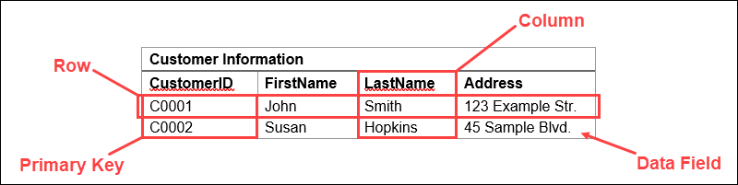
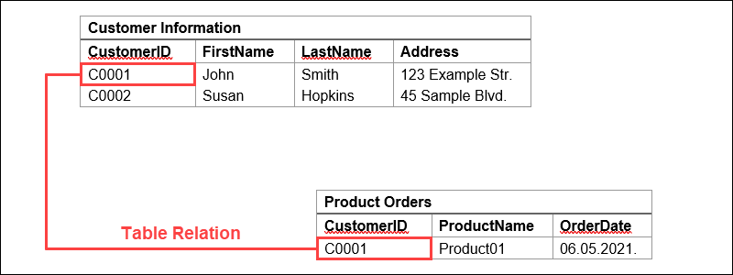

Slide 13
DBMS | RDBMS
Stores smaller amounts of data as files, with no relations. | Stores large amounts of data as tables that are related to each other.
Can only access one data element at a time. | Can access multiple data elements at the same time.
Working with large amounts of data makes fetching slower. | Relational approach allows data fetching to remain fast even for large databases.
No database normalization. | Allows database normalization.
Does not support distributed databases. | Supports distributed databases.
Supports a single user. | Supports multiple users.
Lower security level. | Multiple security levels.
Low software and hardware requirements. | High software and hardware requirements.

Slide 14
Non-Relational DB
Non-relational databases (often called NoSQL databases) are different from traditional relational databases in that they store their data in a non-tabular form.
A non-relational database is any database that does not use the tabular schema of rows and columns like in relational databases. Rather, its storage model is optimized for the type of data it’s storing.
Non-relational databases are also known as NoSQL databases which stands for “Not Only SQL.” Where relational databases only use SQL, non-relational databases can use other types of query language.

Slide 15
There are four different types of NoSQL databases.
Document-oriented databases – Also known as a document store, this database is designed for storing, retrieving and managing document-oriented information. Document databases usually pair each key with a complex data structure (called a document).
Key-Value Stores – This is a database that uses different keys where each key is associated with only one value in a collection. Think of it as a dictionary. This is one of the simplest database types among NoSQL databases.
Wide-Column Stores – this database uses tables, rows, and columns, but unlike a relational database, the names and format of the columns can vary from row to row in the same table.
Graph Stores – A graph database uses graph structures for semantic queries with nodes, edges, and properties to represent and store data.

Slide 16
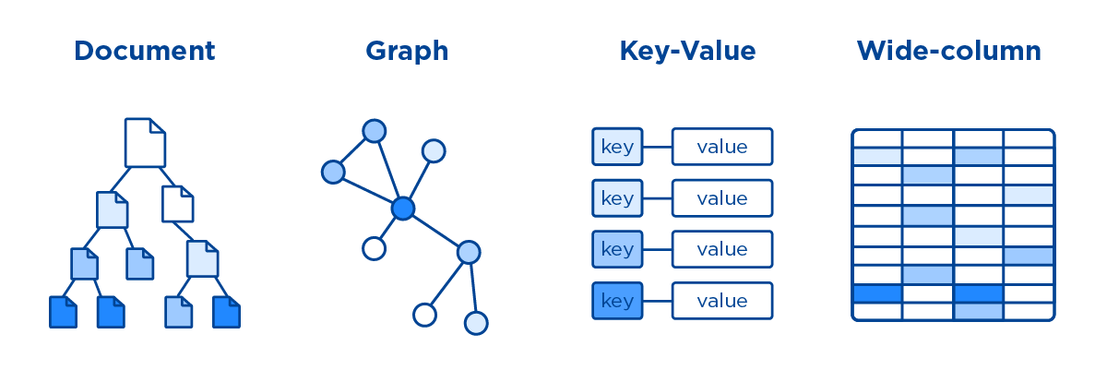
No-sql Dbs
Examples:- MongoDB, Redis, Aws Dynamo DB etc.

Slide 17
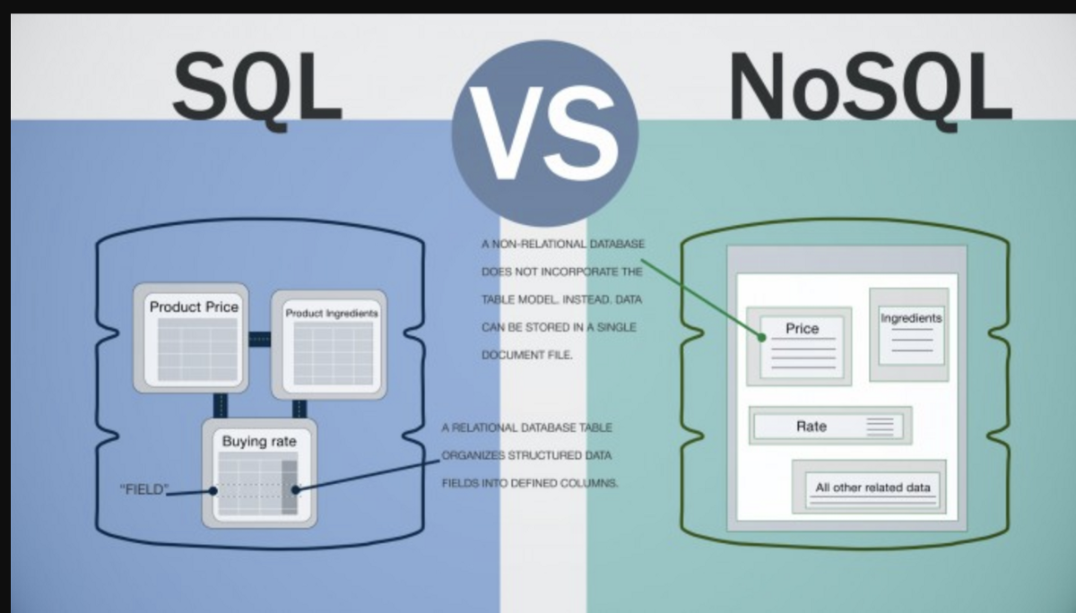
sQL VS NoSQL

Slide 18
SQL
SQL is a standard database programming language used for accessing and manipulating data in a database.
SQL is used by many databases like MySQL, Oracle, SQL Server, PostgreSQL, etc.
There are lots of different database systems, or DBMS (Database Management Systems), such as:
Microsoft SQL Server, Oracle database
MySQL (Oracle, earlier name as Sun Microsystems) - MySQL is used for free of charge (open source license); examples of those websites that use MySQL are YouTube, Wikipedia, Facebook
IBM DB2
Sybase

